Slide 1
Snyder’s Sandwich
Public-Private-Partnership (P3) Transportation Projects in Massachusetts
Presentation to Legislators of
Project Mobility and Project Span
October 2, 2014

Slide 2
Introduction
“WHAT”
MassDOT is in the early stages of planning the procurement of two major transportation projects as Public Private Partnerships (P3s):
Project Span – a 3rd crossing over the Cape Cod Canal
Project Mobility – “Express Toll Lanes” on Route 3 South
~~~~~~~~~~~~~~~~~~~~~~~~~~~~~~~~~~~~~~~~~~~~~~~~~~~~~~~~~~~~~
The P3 construct is also known as a Design-Build-Finance–Maintain-Operate (DBFOM) procurement.
DBFOM shifts construction, financing, and operational risk to the private sector in return for the private sector being given the right to operate and maintain the asset and to earn an investment return for bearing those risks.
Each asset will be constructed, maintained and operated to Commonwealth standards.
Both facilities will be tolled as a way to finance their construction, maintenance and operation.

Slide 3
Introduction
“What” (cont’d.)
USDOT’s Definition of a Transportation PPP:
A P3 describes a contractual arrangement between a Department (public authority) and a Developer (private entity) in connection with the design, construction, financing, operation and maintenance of an asset that will be used by or is otherwise valuable to the public. Unlike conventional methods of contracting for new construction (e.g., design-build), in which discrete functions are divided and procured through separate solicitations, P3 transactions contemplate a single private entity (generally a consortium of private companies comprising the Developer) which is responsible and financially liable for performing all or a significant number of the Project functions, including design, construction, financing, operation and maintenance. In recent years, Departments, including transportation agencies, have turned to P3 transactions to procure new transportation facilities, including highway projects, in an attempt to obtain time savings, cost savings, and more innovative, higher quality Projects with reduced risks. In exchange, the Developer receives the opportunity to earn a financial return commensurate with the risks it has assumed either through the receipt of Toll Revenues (on which the Developer takes both demand risk and toll collection revenue risk) or availability payments (on which the Developer takes appropriations risk) on such terms as may be outlined under the Concession Agreement.

Slide 4
Introduction
“HOW”
P3 Commission Process Guidelines
Outreach to Legislators – October 2
Outreach to local electeds, Chambers of Commerce, and other stakeholders - first “working group” meeting for Project Span – October 8 and more dates
Attract private sector (construction companies, infrastructure investors, engineers, lenders, etc.) to Design-Build-Finance-Maintain-Operate the facilities starting with Industry Days - October 15th and 16th
RFI
RFQ
Complete the Environmental process – both NEPA and MEPA – for the purpose of getting permits to build and operate.
RFP
Build and Operate

Slide 5
“WHY” P3
The Commonwealth has passed legislation allowing for P3s, and Project Mobility and Project Span are both well-suited to be procured under the P3 structure.
Availability of Capital
Risk Transfer
Private Sector Expertise

Slide 6
Meeting Agenda
Project Mobility
Congestion on Route 3 South has been an issue for decades
  The Express Toll Lane option may provide a viable solution to increased capacity
  The Project was advanced by the Public-Private Oversight Commission as a candidate for Alternative Project Delivery as a P3
What is an Express Toll Lane, and how would this work?
Design Concepts
Project Span
The two aging bridges that provide the only vehicle access over Cape Cod Canal raise questions of mobility and emergency access
  A new third bridge will provide reliable, safe and modern access to the Cape
  The Project was advanced by the Public-Private Oversight Commission as a candidate for Alternative Project Delivery as a P3
Project description and alternatives
Possible transaction structures
Progress update

Slide 7
Project Mobility

Slide 8
Identified objectives for the Route 3 South Express Toll Lanes
Mobility
  Improve travel time reliability along Route 3 South in both the north and south bound directions
Safety
  Improve the safety of drivers in the corridor by restoring the shoulder, as required by FHWA if capacity is added
Bus Transit
  Enhance existing bus transit alternatives, market this improved service, and increase ridership
Project Delivery
  Demonstrate the viability of alternative delivery options in Massachusetts and provide opportunity for private investment

Slide 9
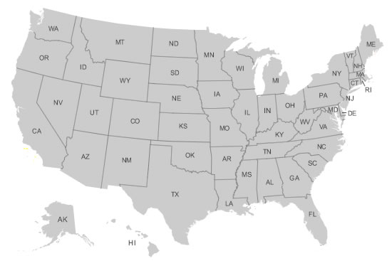

Express Toll Lanes have been increasingly adopted as a solution for congested urban roads
SR-167 HOT Lanes – 2008
I-35 – 2009 & I-394 Express – 2005
I-15 Express Lanes - 2001
Capital Beltway (I-495) Express - 2012
I-680 Express Lanes - 2010
237 Express Lanes – 2012
I-25 Express Lanes – Exp. 2015 &
US Route 36 - Exp. 2016
I-95/395 – Exp. 2016
SR-91 Express Lanes -1995
I-77 Express Lanes – Exp. 2018
LBJ Express Lanes – Exp. 2016
I-15 Fastrak – 1998
Tampa Hillsborough Express Way – 2006
North Tarrant Express Lanes – Exp. 2017
I-85 Express Lanes – 2011
Katy Managed Lanes (I-10) - 2008
I-595 Express Lanes – 2014
95 Express Lanes – 2010

Slide 10
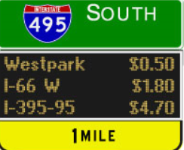
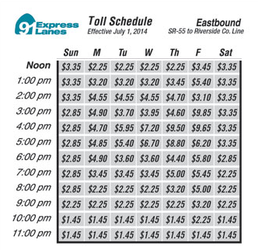
Express Toll Lanes – An Overview
Express Toll Lanes (or “Managed Lanes” as the terms are used interchangeably) are defined as tolled lanes running parallel to existing toll-free general purpose lanes where the toll rate will adjust based upon demand
  According to the US DOT, Express Toll Lanes “are defined as highway facilities or a set of lanes where operational strategies are proactively implemented and managed in response to changing conditions.”
Toll rates are used to manage demand to ensure free flow conditions in one of two methods:
  “Dynamic Pricing”: Rates are set in real time based upon current traffic conditions; or
  “Time of Day Pricing”: Rates are fixed by hour based and adjusted periodically on traffic conditions.
After the introduction of this concept twenty years ago in Southern California, ten states have implemented this approach to addressing peak hour congestion
Dynamic Pricing
Time of Day Pricing

Slide 11
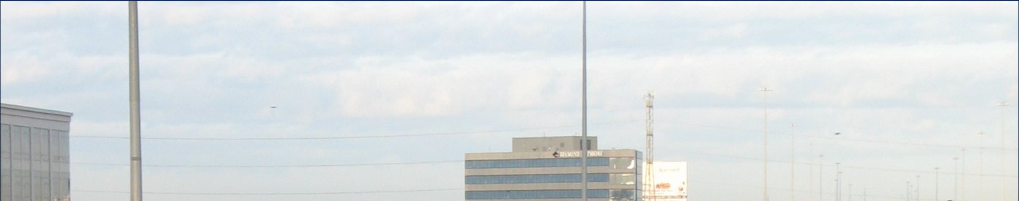
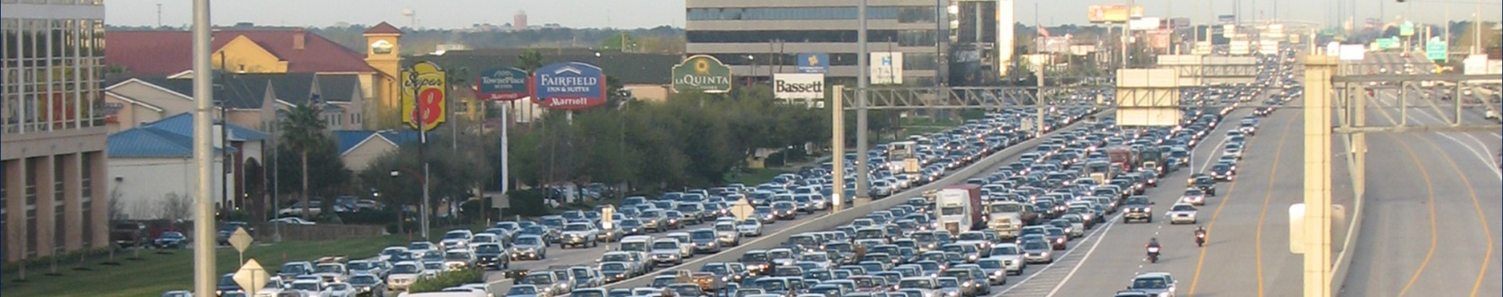
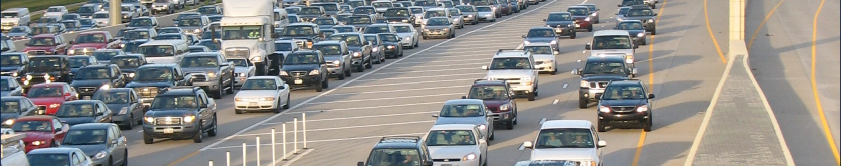
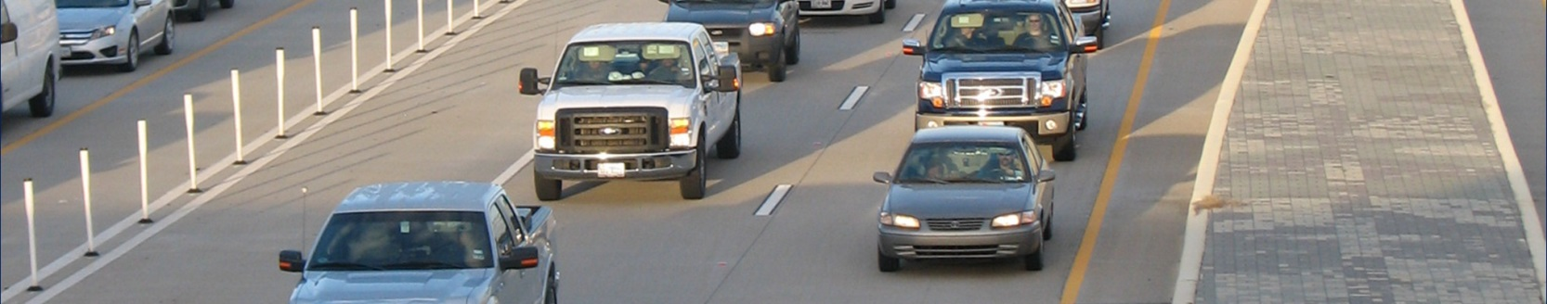
Express Toll Lanes: Overview - Katy Freeway (Houston, Texas)
Frontage Road Lanes
General Purpose Lanes
Express Toll Lanes

Slide 12
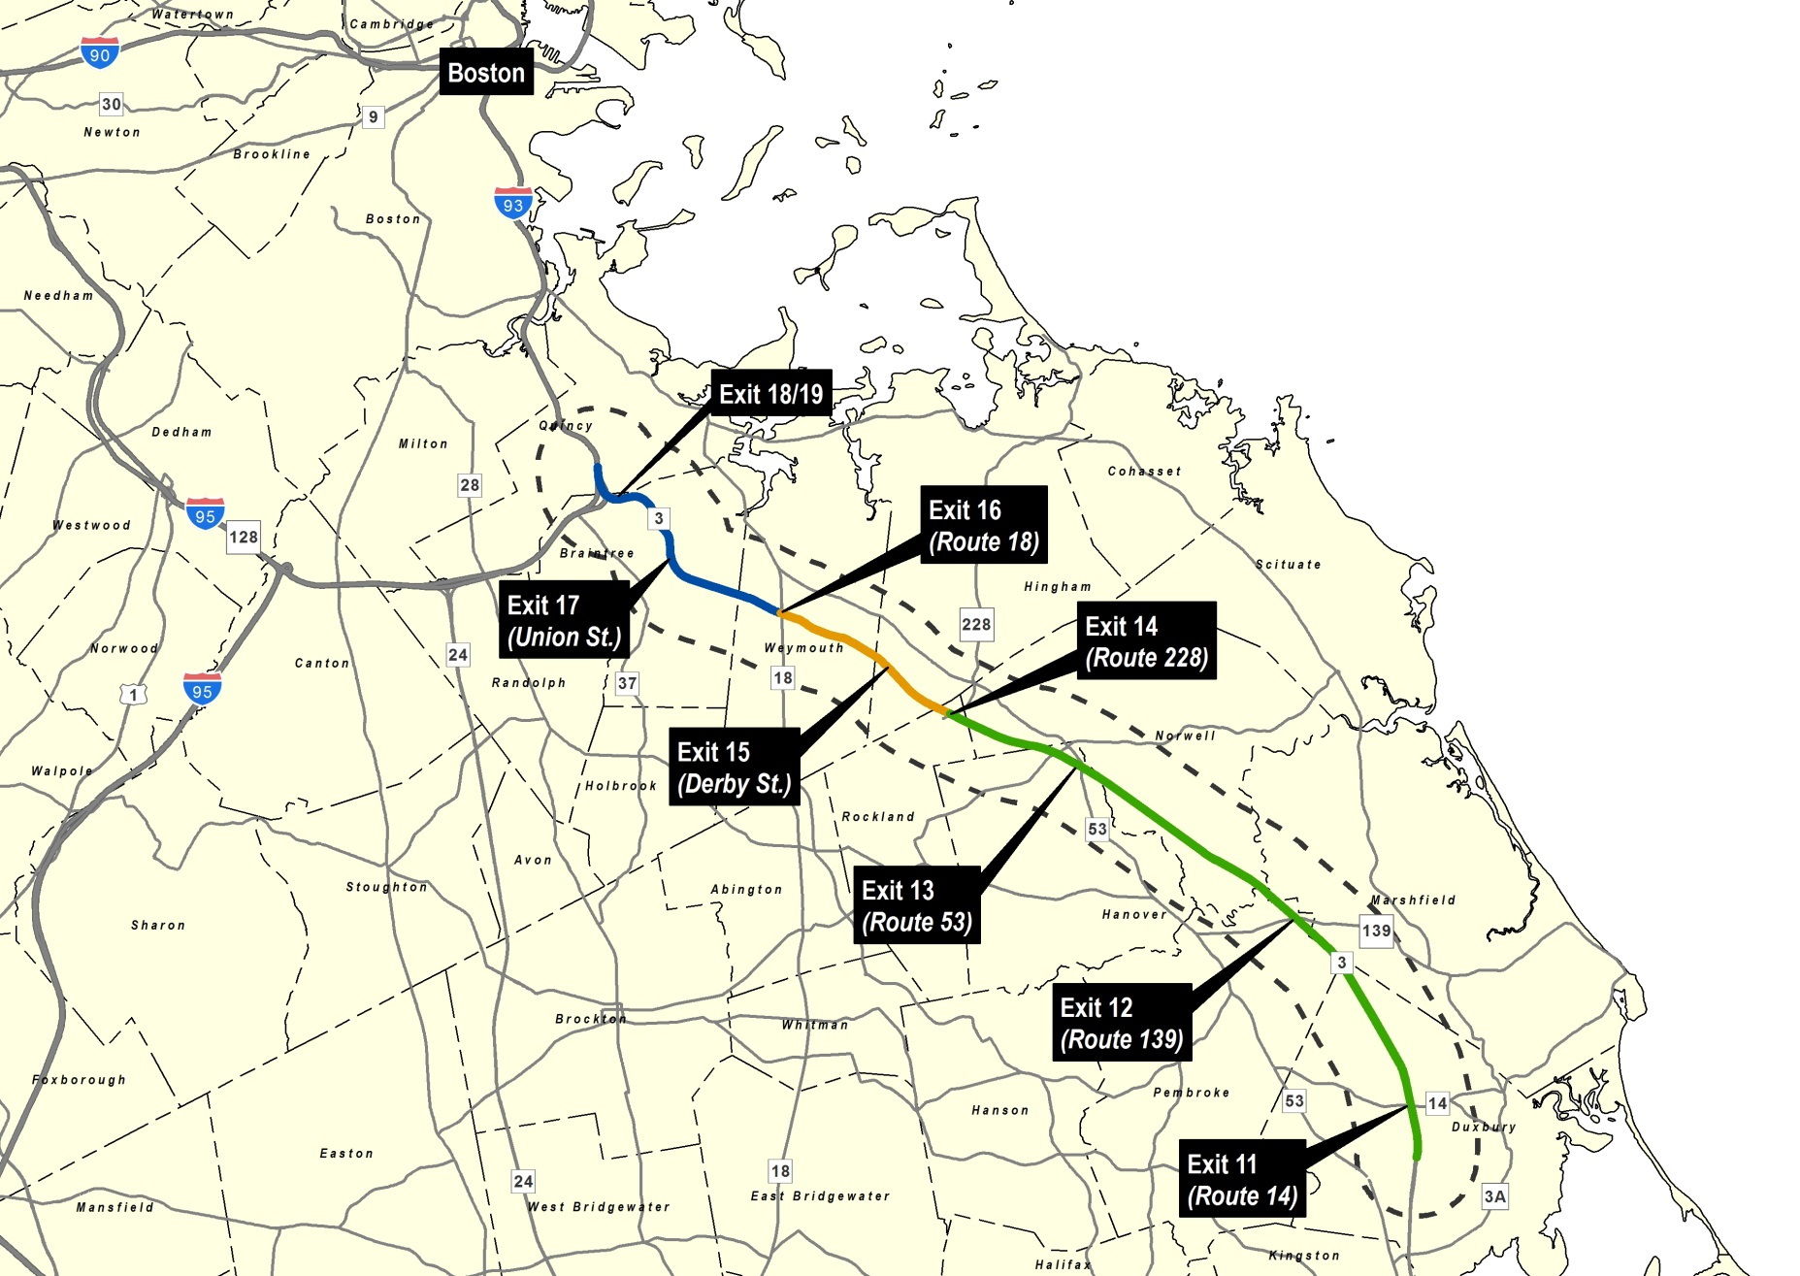
Design effort has identified three specific sections of Rt. 3 South for typical cross sections
Crash Data: 2009 - 2011
Exit | Number of Crashes
11 | 76
12 | 123
13 | 70
14 | 100
15 | 153
16 | 308
17 | 154
18 & 19 | Not Available
Breakdown Lane in Use
Exit 19

Slide 13
Route 3 Alternatives being considered under Project Mobility
The project limits are being evaluated from Braintree to Duxbury
  The State Highway Layout varies in width along Route 3 from Braintree, where the median is typically 46-feet wide, to Duxbury, where the median is approximately 96 feet wide. The middle section in the Hingham area has a 118 foot median typically
  Consequently, the project has been broken into three segments to determine where the Express Toll Lanes would be located and to determine what their impacts might be
  The next slides show options for each of the three sections
Several Express Toll Lane Options are being evaluated
  A two-lane reversible facility in the median would operate only during peak hours
  There could be one permanent lane – collecting tolls 24/7 – in each direction attached to the northbound and southbound barrels in the median
Ingress and Egress Points are also being evaluated
  Tolls would likely be charged for each segment of the toll lanes between ingress and egress points
  There will always be the free alternative of the general purpose lanes

Slide 14
South Section – Exit 11 (Route 14/Congress Street) to Exit 14 (Route 228/Hingham Street)
 |  |  |  |  |  |  |  |  |  |  |  |  |  |  |  |  |  |  |  |  |  |  |  |  |  |  |  |  |  |  |  |  |  |  |  |  |  |  |  |  |  |  |  |  |  |  |  |  |  |  |  |  |  |  |  |  |  |  |  |  |  | Legend
 |  |  |  |  |  |  |  |  |  |  |  |  |  |  |  |  |  |  |  |  |  |  |  |  |  |  |  |  |  |  |  |  |  |  |  |  |  |  |  |  |  |  |  |  |  |  |  |  |  |  |  |  |  |  |  |  |  |  |  |  |  |  |  | Concrete Median Barrier
Option #1
Two Express Toll Lanes Reversible At Grade
Two General Purpose Lanes and Restored Shoulder NB and SB No Widening Required
 |  |  |  |  |  |  |  |  |  |  |  |  |  |  |  |  |  |  |  |  |  |  |  |  |  |  |  |  |  |  |  |  |  |  |  |  |  |  |  |  |  | 172
 |  |  |  |  |  |  |  | 38 |  |  |  |  |  |  |  |  |  |  |  |  |  |  |  |  |  |  |  |  |  |  |  |  |  |  |  |  |  |  |  |  |  | 96 |  |  |  |  |  |  |  |  |  |  |  |  |  |  |  |  |  |  |  |  |  |  |  |  |  |  |  |  |  |  |  |  |  |  |  | 38
 |  |  |  |  |  |  |  |  |  |  |  |  |  |  |  |  |  |  |  |  |  |  |  |  |  |  |  | 40 |  |  |  |  |  |  |  |  |  |  |  |  |  |  |  |  |  |  |  |  |  |  | 56
 |  |  |  |  |  |  |  | 12 |  |  |  |  | 12 |  |  |  |  |  | 2 |  |  |  |  |  |  |  | 12 |  |  |  |  |  | 12 |  |  |  |  |  |  |  |  |  |  |  |  |  |  |  |  |  |  |  |  |  |  |  |  |  |  |  |  |  |  |  |  |  |  |  |  |  |  |  | 12 |  |  |  |  |  | 12
 | Southbound 2 General Purpose Lanes and Restored Shoulder |  |  |  |  |  |  |  |  |  |  |  |  |  |  |  | Shd |  |  | Shoulder |  |  |  |  |  | Two Express Toll Lanes |  |  |  |  |  |  |  |  |  |  | Shd |  |  |  |  | Open Median |  |  |  |  |  |  |  |  |  |  |  |  |  |  |  |  |  |  |  |  |  |  |  |  |  |  |  |  | Northbound 2 General Purpose Lanes and Restored Shoulder
 |  |  |  |  |  |  |  |  |  |  |  |  |  |  |  |  |  |  |  |  |  |  |  |  |  | Reversible at grade
Option #2
Two Express Toll Lanes Fixed At Grade - One NB and One SB Two General Purpose Lanes and Restored Shoulder NB and SB No Widening Required
 |  |  |  |  |  |  |  |  |  |  |  |  |  |  |  |  |  |  |  |  |  |  |  |  |  |  |  |  |  |  |  |  |  |  |  |  |  |  |  |  |  |  |  |  |  |  | 172
 |  |  |  |  |  |  |  | 38 |  |  |  |  |  |  |  |  |  |  |  |  |  |  |  |  |  |  |  |  |  |  |  |  |  |  |  |  |  |  |  |  |  |  |  |  |  |  | 96 |  |  |  |  |  |  |  |  |  |  |  |  |  |  |  |  |  |  |  |  |  |  |  |  |  |  |  |  |  |  |  |  |  |  |  | 38
 |  |  |  |  |  |  |  |  |  |  |  |  |  |  |  |  |  |  |  |  |  |  |  |  |  | 28 |  |  |  |  |  |  |  |  |  |  |  |  |  |  |  |  |  |  |  |  | 40 |  |  |  |  |  |  |  |  |  |  |  |  |  |  |  |  |  |  | 28
 |  |  |  |  |  |  |  | 12 |  |  |  |  | 12 |  |  |  |  |  | 2 |  |  |  |  |  |  |  | 12 |  |  |  |  |  |  |  |  |  |  |  |  |  |  |  |  |  |  |  |  |  |  |  |  |  |  |  |  |  |  |  |  |  |  |  |  | 12 |  |  |  |  |  |  |  |  | 2 |  |  |  |  | 12 |  |  |  |  |  | 12
 | Southbound 2 General Purpose Lanes and Restored Shoulder |  |  |  |  |  |  |  |  |  |  |  |  |  |  |  |  |  |  | Shoulder |  |  |  |  | Express Toll |  |  |  |  |  |  |  |  |  |  | Open Median |  |  |  |  |  |  |  |  |  |  |  |  |  |  |  |  |  |  |  |  |  |  |  |  |  | Express Toll |  |  |  |  |  | Shoulder |  |  |  |  |  |  |  | Northbound 2 General Purpose Lanes and Restored Shoulder
 |  |  |  |  |  |  |  |  |  |  |  |  |  |  |  |  |  |  |  |  |  |  |  |  |  | Lane |  |  |  |  |  |  |  |  |  |  |  |  |  |  |  |  |  |  |  |  |  |  |  |  |  |  |  |  |  |  |  |  |  |  |  |  | Lane

Slide 15
Middle Section - Exit 14 (Route 228/Hingham) to Exit 16 (Route 18/Main Street)
 |  |  |  |  |  |  |  |  |  |  |  |  |  |  |  |  |  |  |  |  |  |  |  |  |  |  |  |  |  |  |  |  |  |  |  |  | Legend
 |  |  |  |  |  |  |  |  |  |  |  |  |  |  |  |  |  |  |  |  |  |  |  |  |  |  |  |  |  |  |  |  |  |  |  |  |  |  | Concrete Median Barrier
Option #1
Two Express Toll Lanes Reversible At Grade
Two General Purpose Lanes and Restored Shoulder NB and SB
No Widening Required
 |  |  |  |  |  |  |  |  |  |  |  |  |  |  |  |  |  |  |  |  |  |  |  |  |  |  |  |  |  |  | 118
 |  |  |  |  |  |  |  |  |  |  | 38 |  |  |  |  |  |  |  |  |  |  |  |  |  |  |  |  |  |  |  | 42 |  |  |  |  |  |  |  |  |  |  |  |  |  |  |  |  |  |  |  | 38
 |  |  |  |  |  |  |  |  |  | 12 |  |  |  |  |  | 12 |  |  |  |  |  | 2 |  |  |  |  |  |  |  | 12 |  |  |  |  |  | 12 |  |  |  |  |  | 2 |  |  |  |  | 12 |  |  |  |  |  | 12
 |  |  |  | Southbound 2 General Purpose Lanes and Restored Shoulder |  |  |  |  |  |  |  |  |  |  |  |  |  |  |  | Shd |  |  | Shoulder |  |  |  |  |  | Two Express Toll Lanes |  |  |  |  |  |  |  |  |  |  | Shd |  |  | Shd |  |  | Northbound 2 General Purpose Lanes and Restored Shoulder
 |  |  |  |  |  |  |  |  |  |  |  |  |  |  |  |  |  |  |  |  |  |  |  |  |  |  |  |  | Reversible at grade
Option #2
Two Express Toll Lanes Fixed At Grade – One NB and One SB
Two General Purpose Lanes and Restored Shoulder NB and SB
Requires 8-ft Widening
 |  |  |  |  |  |  |  |  |  |  |  |  |  |  |  |  |  |  |  |  |  |  |  |  |  |  |  |  |  |  | 130
 |  |  |  |  |  |  |  | 38 |  |  |  |  |  |  |  |  |  |  |  |  |  |  |  |  |  |  |  |  |  |  | 54 |  |  |  |  |  |  |  |  |  |  |  |  |  |  |  |  |  |  |  |  |  | 38
 |  |  |  |  |  |  |  | 12 |  |  |  |  | 12 |  |  |  |  |  | 2 |  |  |  |  |  |  |  | 12 |  |  |  |  | 2 |  |  |  | 12 |  |  |  |  |  |  |  |  | 2 |  |  |  |  | 12 |  |  |  |  |  | 12
 | Southbound 2 General Purpose Lanes and Restored Shoulder |  |  |  |  |  |  |  |  |  |  |  |  |  |  |  | Shd |  |  | Shoulder |  |  |  |  | Express Toll Lane |  |  |  |  |  |  |  |  | Express Toll Lane |  |  |  |  |  | Shoulder |  |  |  |  |  | Shd |  | Northbound 2 General Purpose Lanes and Restored Shoulder

Slide 16
North Section - Exit 16 (Route 18/Main Street) to Exit 19 (Burgin Parkway)
 |  |  |  |  |  |  |  |  |  |  |  |  |  |  |  |  |  |  |  |  |  |  |  |  |  |  |  |  |  |  |  |  |  |  |  |  | Legend
 |  |  |  |  |  |  |  |  |  |  |  |  |  |  |  |  |  |  |  |  |  |  |  |  |  |  |  |  |  |  |  |  |  |  |  |  |  |  | Concrete Median Barrier
Option #1 Two Express Toll Lanes Reversible At Grade Three General Purpose Lanes and 10-ft Shoulder NB and SB Requires 44-ft Widening Limited ROW Available Requires Reconstruction of Washington Street and Elm Street Bridges
 |  |  |  |  |  |  |  |  |  |  |  |  |  |  |  |  |  |  |  |  |  |  |  |  |  |  |  |  |  |  |  |  |  |  |  |  |  | 154
 |  |  |  |  |  |  |  |  |  |  |  |  | 56 |  |  |  |  |  |  |  |  |  |  |  |  |  |  |  |  |  |  |  |  |  |  |  | 42 |  |  |  |  |  |  |  |  |  |  |  |  |  |  |  |  |  |  |  |  |  |  |  |  | 56
 |  |  |  |  |  |  |  | 12 |  |  |  |  | 12 |  |  |  |  |  | 12 |  |  |  |  |  |  |  |  | 2 |  |  |  |  |  |  |  | 12 |  |  |  |  |  | 12 |  |  |  |  |  | 2 |  |  |  |  |  |  |  | 12 |  |  |  |  |  | 12 |  |  |  |  |  | 12
Shoulder |  |  |  |  | Southbound 3 General Purpose Lanes |  |  |  |  |  |  |  |  |  |  |  |  |  |  |  |  |  | Shoulder |  |  |  |  |  | Shoulder |  |  |  |  | Two Express Toll Lanes |  |  |  |  |  |  |  |  |  |  |  | Shd |  |  | Shoulder |  |  |  |  | Northbound 3 General Purpose Lanes |  |  |  |  |  |  |  |  |  |  |  |  |  |  |  |  |  | Shoulder
 |  |  |  |  |  |  |  |  |  |  |  |  |  |  |  |  |  |  |  |  |  |  |  |  |  |  |  |  |  |  |  |  |  | Reversible at grade
Option #2 Two Express Toll Lanes Fixed At Grade - One NB and One SB Three General Purpose Lanes and 10-ft Shoulder NB and SB Requires 56-ft Widening Limited ROW Available Requires Reconstruction of Washington Street and Elm Street Bridges
 |  |  |  |  |  |  |  |  |  |  |  |  |  |  |  |  |  |  |  |  |  |  |  |  |  |  |  |  |  |  |  |  |  |  |  |  |  |  |  | 166
 |  |  |  |  |  |  |  |  |  | 56 |  |  |  |  |  |  |  |  |  |  |  |  |  |  |  |  |  |  |  |  |  |  |  |  |  |  |  |  |  | 54 |  |  |  |  |  |  |  |  |  |  |  |  |  |  |  |  |  |  |  |  |  |  |  |  |  |  |  | 56
 |  |  |  |  |  |  |  | 12 |  |  |  |  | 12 |  |  |  |  |  | 12 |  |  |  |  |  |  |  |  | 2 |  |  |  |  |  |  |  | 12 |  |  |  |  | 2 |  |  |  | 12 |  |  |  |  |  |  |  |  | 2 |  |  |  |  |  |  |  | 12 |  |  |  |  |  | 12 |  |  |  |  |  | 12
Shoulder |  |  |  |  | Southbound 3 General Purpose Lanes |  |  |  |  |  |  |  |  |  |  |  |  |  |  |  |  |  | Shoulder |  |  |  |  |  | Shoulder |  |  |  |  | Express Toll Lane |  |  |  |  |  |  |  |  | Express Toll Lane |  |  |  |  |  | Shoulder |  |  |  |  |  | Shoulder |  |  |  |  | Northbound 3 General Purpose Lanes |  |  |  |  |  |  |  |  |  |  |  |  |  |  |  |  |  | Shoulder

Slide 17
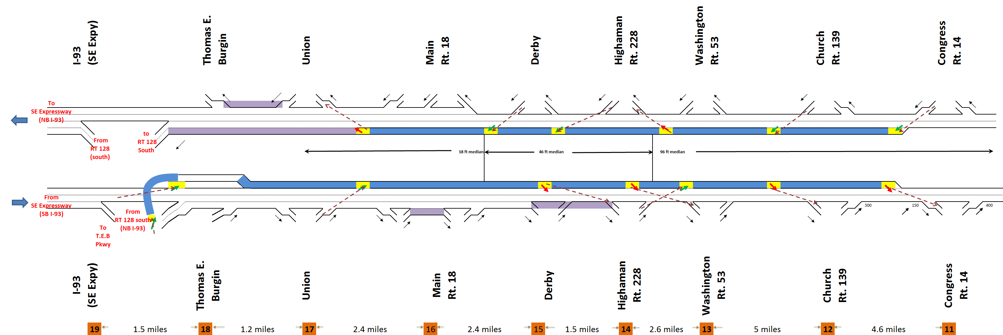
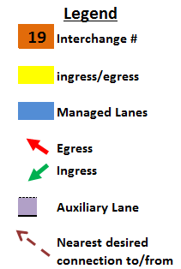
Initial Assumptions for Access and Egress to Managed Lanes
While it is difficult to present a 22-mile Project on one page, preliminarily there are four access points and two egress points northbound, and four access points and three egress points southbound.

Slide 18
Project Mobility working group is Parallel Tracking the Project’s critical path activities
Project Feasibility
Environmental Review
Outreach
Traffic and revenue forecasting analysis and engineering and design estimates
Potential number of project scope scenarios has been narrowed
Determination of initial feasibility assessment in October
Both a MEPA EIR and NEPA environmental documentation will be required with permitting
These environmental reviews are likely to be the critical path to groundbreaking
Initial meetings with Massachusetts Environmental Affairs and Federal Highway Administration have been held
The Project Team will attempt to accelerate environmental review
Outreach to key constituencies is critical to any large transportation development effort
Goal is transparency and identification of key issues early in the process
Initiation of this effort will follow initial feasibility review
Second aspect of outreach is to the transportation development industry
Initial interest has been strong

Slide 19
Project Mobility Timeline for next several months
Project Mobility: Immediate Timeline
September | October | November | December
Initial forecast of potential revenue and project cost Feasibility assessment | Briefing of legislative leaders Industry Day Industry meetings Refinement of design alternatives P3 Commission Board Meeting | Initiate Level 2 traffic modeling MPOs vote on amendment to add project to Long-Range Plan Draft Environmental Notification Form | Issue Request for Information File Environmental Notification Form NEPA Class of Action Request

Slide 20
Preliminary Project Mobility transaction structure
Private sector consortium will design, build, finance, operate and maintain (DBFOM) the new express toll lanes on Route 3 South under a long-term contract with MassDOT
Toll revenues are expected to provide sufficient return on investment to attract private sector infrastructure investors
Toll rates and revenue potential driven by convenience and time savings offered to drivers on the new express toll lanes.
A free alternative will exist by virtue of the general access lanes which will continue to operate on Route 3 South.
Traffic and revenue studies are underway now to define the scope of likely demand
Toll-free access for emergency responders and other services (buses) will be built into the contract
Possibility remains for MassDOT to collect tolls and make availability payments to the private sector funded by toll revenue, as opposed to a planned lease concession structure.
MassDOT will stipulate design, operations and maintenance standards as part of its contract

Slide 21
Project Span

Slide 22
Project SPAN – Overview and Need
Project SPAN will construct a third crossing of Cape Cod Canal that is intended to deliver reliable, year-round access to the Cape.
At present, the aging Sagamore and Bourne Bridges frequently limit access to Cape Cod, whether due to maintenance requiring lane shutdowns or simply inability to meet traffic demand
  Both bridges are approximately 80 years old and require frequent maintenance
  Four 10-foot lanes, no shoulder and lack of separation of opposing traffic cause safety concerns
Current bridges carry an average of 94,000 vehicles per day, split roughly 55% Sagamore/45% Bourne
  Peak traffic occurs in July, totaling as many as 128,000 vehicles per day
  Expectation is that the new bridge will ease congestion to and from the Cape, making it more reliable and convenient

Slide 23
Identified objectives for the Third Crossing of Cape Cod Canal
Safety
  Improve emergency evacuation and/or first responder access
Access & Mobility
  Reliable access and mobility ensuring quality of life on the Cape
Connectivity
  Improved connectivity among Routes 3, 6 & 25
Project Delivery
  Demonstrate the viability of alternative delivery options in Massachusetts and provide opportunity for private investment

Slide 24
Recent Activity in the U.S. P3 Toll Bridge/Tunnel Sector
Goethals Bridge Replacement P3
$1.5 billion
Availability/Milestone Payments
TIFIA/PABs
November 2013
Midtown Tunnel P3
$2.1 billion
Toll Revenue
TIFIA/PABs
March 2012
East End Crossing P3
$763 million
Availability/Milestone Payments
PABs
March 2013
Mid-Currituck Bridge P3
$549 million (est.)
Toll Revenue/NCDOT Support
Funding Structure TBD
On Hold for NCDOT Prioritization
Port of Miami Tunnel P3
$860 million
Availability/Milestone Payments TIFIA/Bank Debt
October 2009

Slide 25
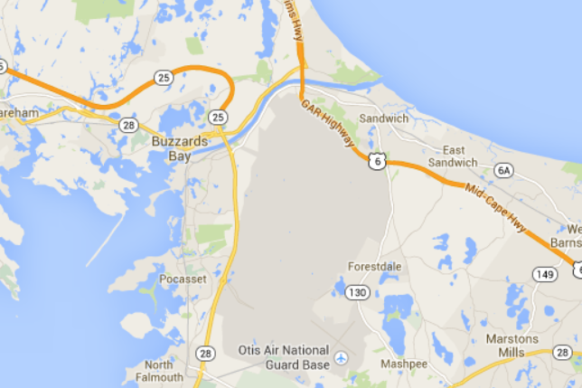
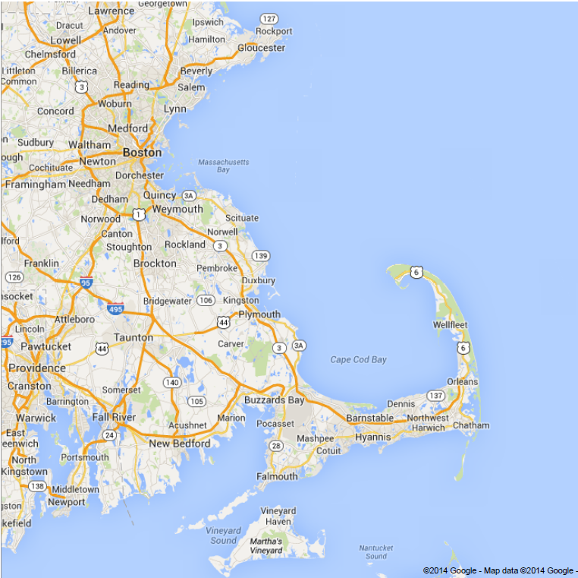
Existing Cape Access
Sagamore Bridge
Bourne Bridge

Slide 26
Potential solutions under consideration
New bridge providing at least one additional lane on-Cape and one off-Cape
Designed to latest safety and multimodal (auto, bicycle, pedestrian) access standards
Project team is considering two possible configurations and locations
Sagamore Twin
  New bridge located immediately west of existing Sagamore Bridge
  Three tolled lanes on-Cape traffic only on the new bridge
  Existing Sagamore converted to off-Cape traffic only (3 lanes, no tolls)
  Existing Bourne Bridge unchanged (2 lanes in each direction, no tolls)
Mid-Canal Crossing
  New bridge located roughly midway between Sagamore and Bourne Bridges
  Two-way, [tolled] traffic with lane configuration to be determined
  Existing Sagamore and Bourne Bridges unchanged (2 lanes in each direction, no tolls)
  Provide opportunities for interconnection of highways
Each bridge configuration includes several possible road configurations for connectivity to Routes 3 & 25 on the mainland and Route 6 on the Cape

Slide 27
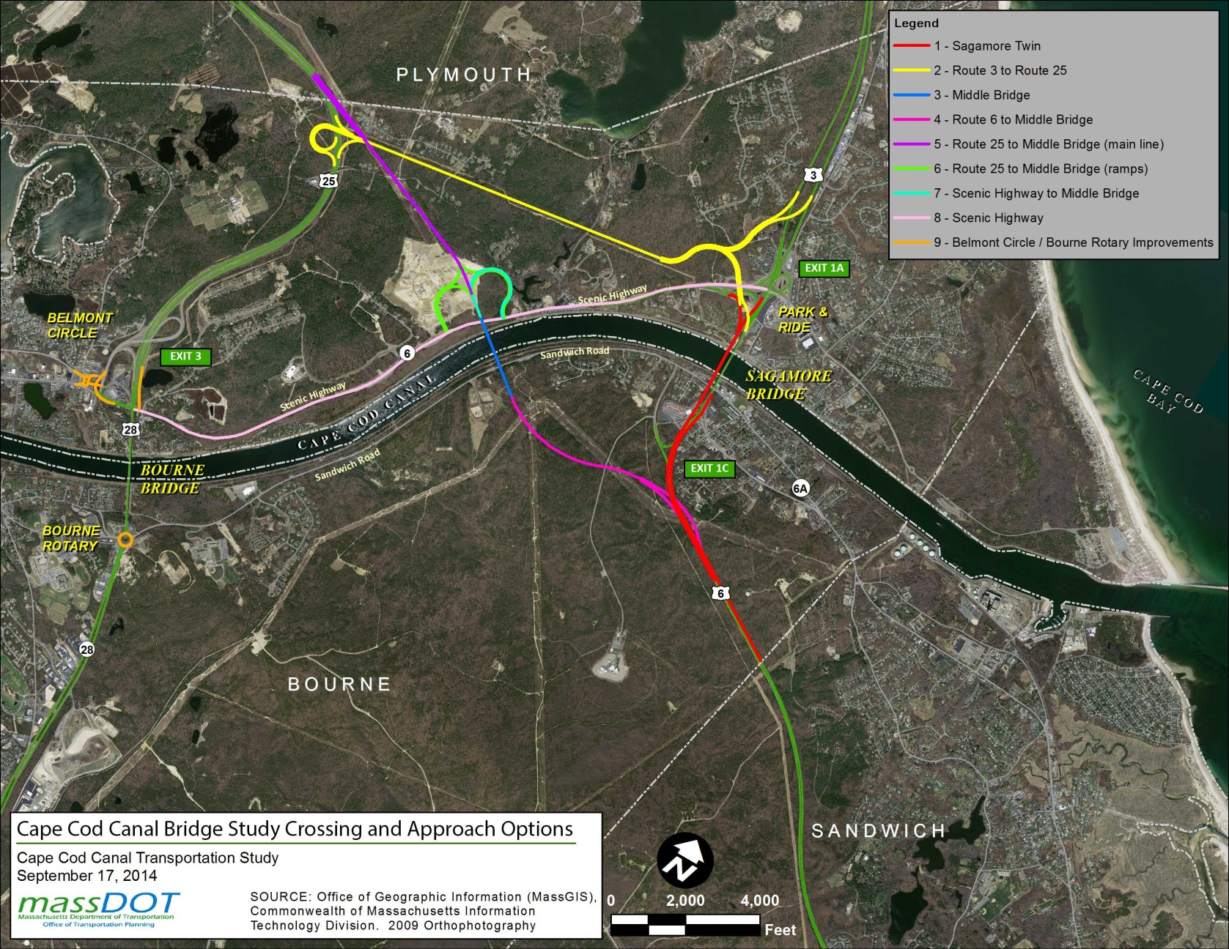
Project SPAN potential configurations

Slide 28
Preliminary Project Span transaction structure
Private sector consortium will design, build, finance, operate and maintain (DBFOM) the new bridge and supporting roadways under a long-term contract with MassDOT
Toll revenues are expected to provide sufficient return on investment to attract private sector infrastructure investors
Toll rates and revenue potential driven by convenience and time savings offered to travelers by the new bridge and supporting roadways
A free alternative on- and off-Cape will continue to exist as long as Sagamore and Bourne Bridges remain in operation
Traffic and revenue studies are underway now to define the scope of likely demand
Toll-free access for emergency responders and evacuation traffic will be built into the contract
Possibility remains for MassDOT to collect tolls and make availability payments to the private sector funded by toll revenue, as opposed to a planned lease concession structure.
MassDOT will stipulate design, operations and maintenance standards as part of its contract

Slide 29
Ongoing Efforts and near-term schedule for both Project Mobility and Project Span
Industry Day scheduled for October 15th-16th, in conjunction with Project Mobility
  Secretary Davey, MassDOT staff and consultants will host likely investors to introduce these projects
  Presentations, site visit, and one-on-one sessions
Request for Information (RFI) to solicit project input from the private sector as a follow-up to Industry Day
Planning effort is underway
  Stakeholder outreach to begin immediately
  Traffic data collection and modeling will lead to in-depth traffic & revenue analysis
  Alternatives analysis based on numerous factors will result in a preferred alignment and location
  Attempting to streamline this process and combine with environmental efforts to minimize lead time
Environmental will follow
  FHWA is expected as the lead agency for environmental approvals for the purpose of NEPA
  Evaluating Environmental work that can be done in parallel with Planning

